Slide 1

Section 4
Flexbox and Grid system

Slide 2
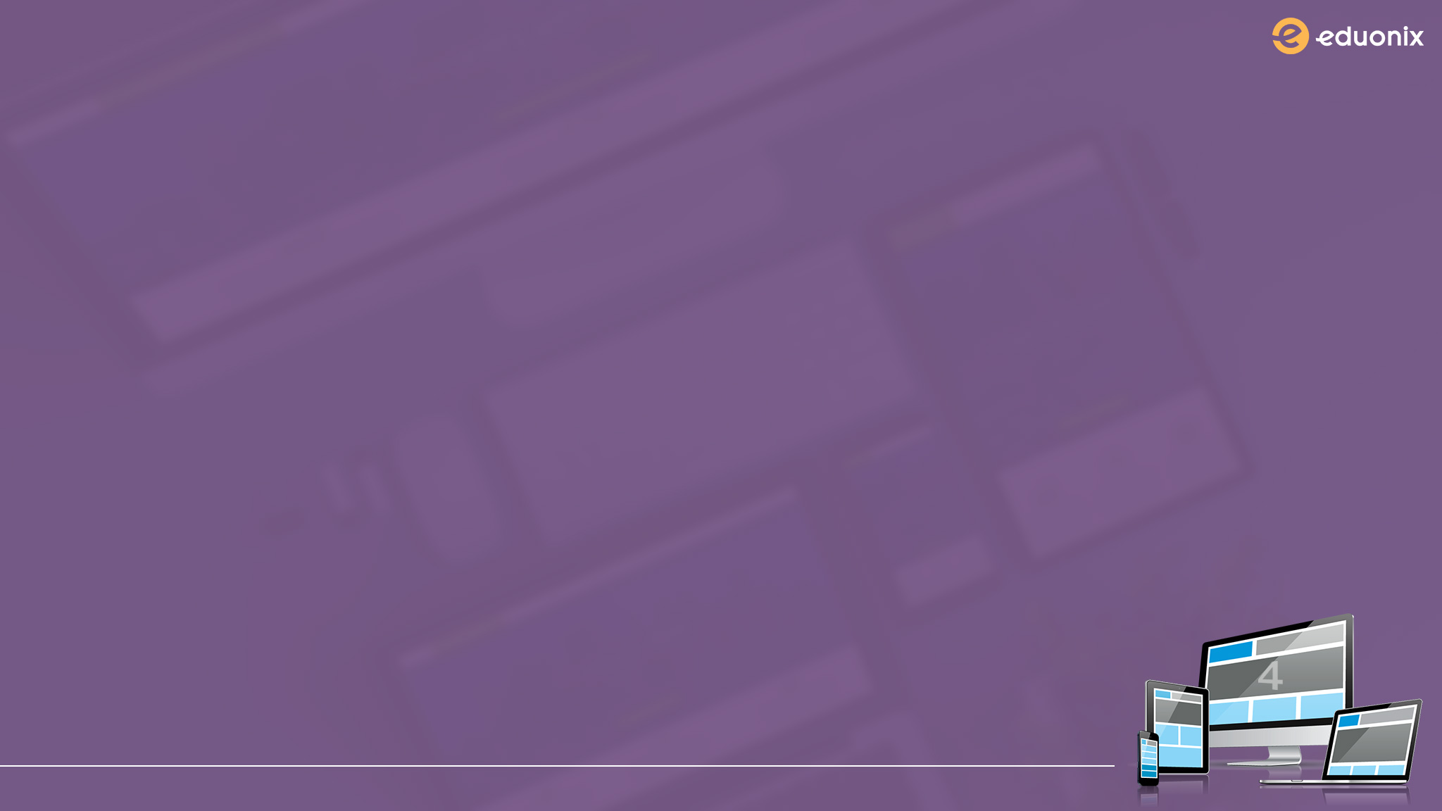
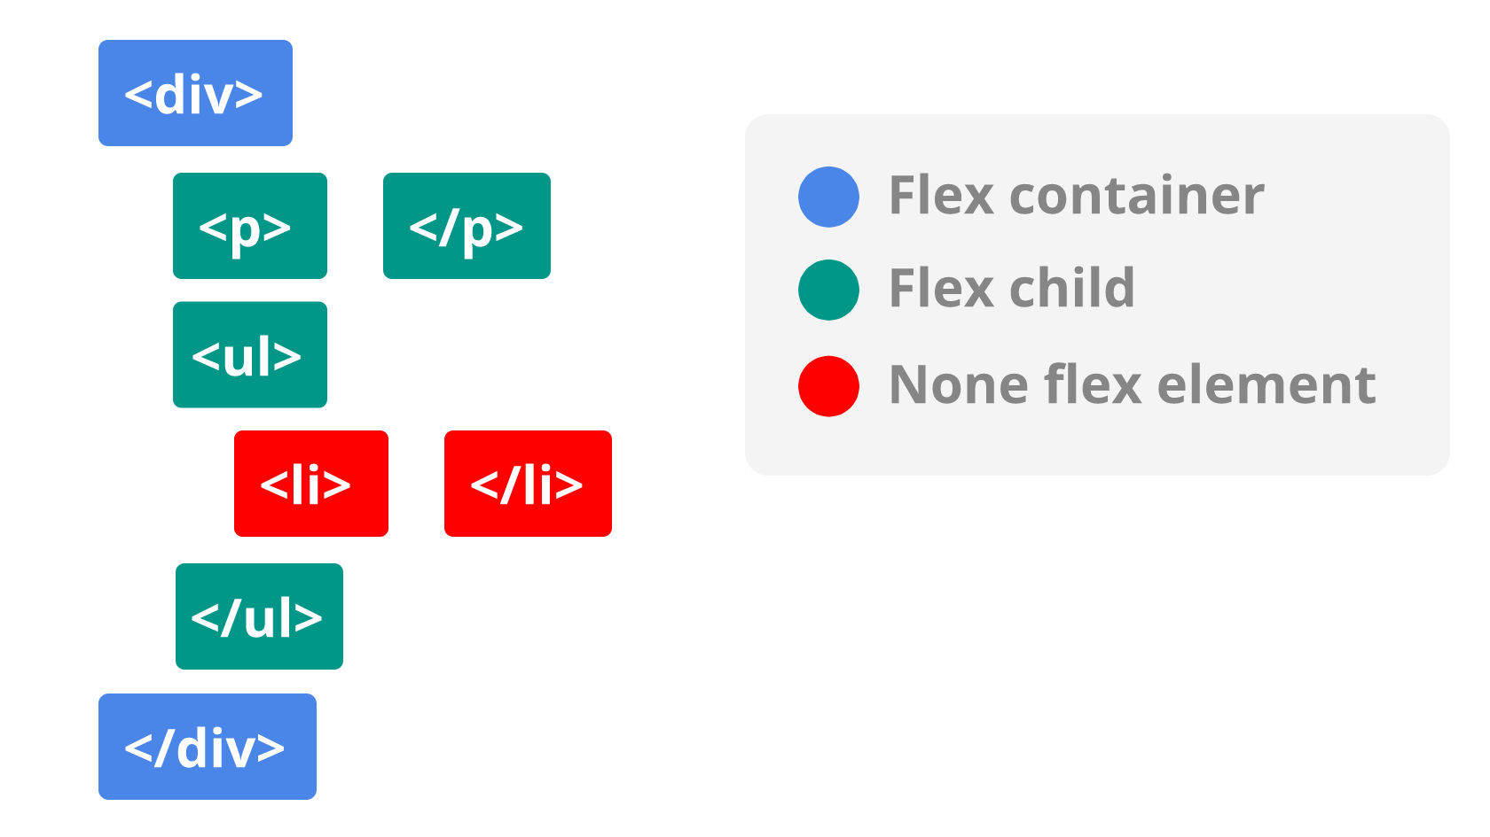
Flexbox

Slide 3
Where to find information
https://css-tricks.com/snippets/css/a-guide-to-flexbox/
https://flexboxfroggy.com/

Slide 4
Installing Bootstrap with NPM
Terminal Commands
pwd - print working directory
cd - change directory
ls - list files in a given directory
cat - display file content (concatenate)

Slide 5
LAB
Create a Checkerboard with bootstrap grid system make sure you use the following:
Vertical Alignment
Do not use column offset
Have 8 rows with 9 tiles in each
Make the board full width of the viewport

